Slide 1

More MIPS, MIPS Functions
Instructor: Rebecca Herman

Slide 2
Review of Last Lecture (1/2)
RISC Design Principles
Smaller is faster: 32 registers, fewer instructions
Keep it simple: rigid syntax
MIPS Registers: $s0-$s7, $t0-$t9, $0
No data types, just raw bits, operations determine how they are interpreted
Memory is byte-addressed
no types → no automatic pointer arithmetic

Slide 3
Review of Last Lecture (2/2)
MIPS Instructions
Arithmetic: add, sub, addi, addu,subu,addiu, mult,div
Data Transfer: lw, sw, lb, sb, lbu, mfhi, mflo
Branching: beq, bne, j, slt, slti
Bitwise: and, or, xor, nor, andi, ori, xori
Shifting: sll, srl, sra, sllv, srlv, srav
MIPS Instructions
Arithmetic: add, sub, addi, addu,subu,addiu, mult,div
Data Transfer: lw, sw, lb, sb, lbu, mfhi, mflo
Branching: beq, bne, j, slt, slti
Bitwise: and, or, xor, nor, andi, ori, xori
Shifting: sll, srl, sra, sllv, srlv, srav
MIPS Instructions
Arithmetic: add, sub, addi, addu,subu,addiu, mult,div
Data Transfer: lw, sw, lb, sb, lbu, mfhi, mflo
Branching: beq, bne, j, slt, slti
Bitwise: and, or, xor, nor, andi, ori, xori
Shifting: sll, srl, sra, sllv, srlv, srav
MIPS Instructions
Arithmetic: add, sub, addi, addu,subu,addiu, mult,div
Data Transfer: lw, sw, lb, sb, lbu, mfhi, mflo
Branching: beq, bne, j, slt, slti
Bitwise: and, or, xor, nor, andi, ori, xori
Shifting: sll, srl, sra, sllv, srlv, srav
MIPS Instructions
Arithmetic: add, sub, addi, addu,subu,addiu, mult,div
Data Transfer: lw, sw, lb, sb, lbu, mfhi, mflo
Branching: beq, bne, j, slt, slti
Bitwise: and, or, xor, nor, andi, ori, xori
Shifting: sll, srl, sra, sllv, srlv, srav
i = “immediate” (constant integer)
u = “unsigned” (doesn’t throw overflow exception)
v = “variable” (takes a register instead of a short immediate)
Notes:
Instructions shown in orange were presented in bonus slides from last lecture.

Slide 4
Agenda
More Memory Instructions
Inequalities
Administrivia
Pseudo-Instructions
Implementing Functions in MIPS
Function Calling Conventions
Bonus: Remaining Registers
Bonus: Memory Address Convention
Bonus: Alternate Register Convention Analogy
Notes:
do additional slt stuff
Then do additional memory instructions
then summarize unsigned?

Slide 5
Memory and Variable Size
So Far:
lw reg, off(bAddr)
sw reg, off(bAddr)
off+bAddr MUST be word-aligned (multiple of 4)
Ex: integer array (each integer is 32 bits = 4 bytes = 1 word)
What about characters (1B) and shorts (sometimes 2B), etc? Want to be able to access memory at addresses that are NOT multiples of 4.
Computer
Processor
Memory
Devices
Control
(“brain”)
Input
lw reg off(bAddr)
Datapath
Registers
sw reg off(bAddr)
Output
Notes:
lb/sb have same syntax as lw/sw
Aside: also load/store halfword (lh/sh)

Slide 6
Trading Bytes with Memory (2 approaches)
Method 1: Move words in and out of memory using bit-masking and shifting
lw $s0,0($s1)
andi $s0,$s0,0xFF # lowest byte
Method 2: Load/store byte instructions
lb $s1,1($s0)
sb $s1,0($s0)
(no longer need to be word aligned)
*($s0) = 0x00000180
00 | 00 | 01 | 80
Notes:
If it’s not aligned, which part of the word are we pulling from?!

Slide 7
Endianness
Big Endian: Most-significant byte at least address of word
word address = address of most significant byte
Little Endian: Least-significant byte at least address of word
word address = address of least significant byte
*($s0) = 0x00000180
big endian
0($s0) 1($s0) 2($s0) 3($s0)
00 | 00 | 01 | 80
msb
lsb
3($s0) 2($s0) 1($s0) 0($s0)
little endian
MIPS is bi-endian (can go either way)
Using MARS simulator in lab, which is little endian

Slide 8
Byte Instructions
lb/sb utilize the least significant byte of the register
On sb, upper 24 bits are ignored
On lb, upper 24 bits are filled by sign-extension
For example, let *($s0) = 0x00000180:
lb $s1,1($s0)
lb $s2,0($s0)
sb $s2,2($s0)
# $s1=0x00000001
# $s2=0xFFFFFF80
# *($s0)=0x00800180

Slide 9
Half-Word Instructions
Unsigned Instructions
lh reg, off(bAddr) “load half”
sh reg, off(bAddr) “store half”
off(bAddr)must be a multiple of 2
On sh, upper 16 bits are ignored
On lh, upper 16 bits are filled by sign-extension
lhu reg, off(bAddr)“load half unsigned”
lbu reg, off(bAddr)“load byte unsigned”
On l(b/h)u, upper bits are filled by zero-extension
Why no s(h/b)u? Why no lwu?

Slide 10
Agenda
More Memory Instructions
Inequalities
Administrivia
Pseudo-Instructions
Implementing Functions in MIPS
Function Calling Conventions
Bonus: Remaining Registers
Bonus: Memory Address Convention
Bonus: Alternate Register Convention Analogy
Notes:
do additional slt stuff
Then do additional memory instructions
then summarize unsigned?

Slide 11
Inequalities in MIPS
Set Less Than (slt)
slt dst,reg1,reg2
if value in src1 < value in src2, dst = 1, else 0
Set Less Than Immediate (slti)
slti dst,reg1,imm
If value in reg1 < imm, dst = 1, else 0
What if we want to compare unsigned numbers?

Slide 12
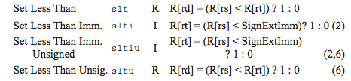
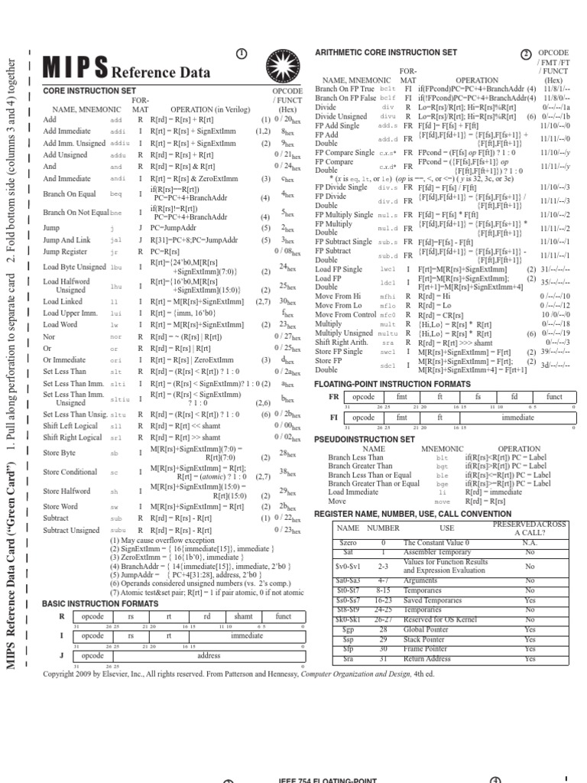
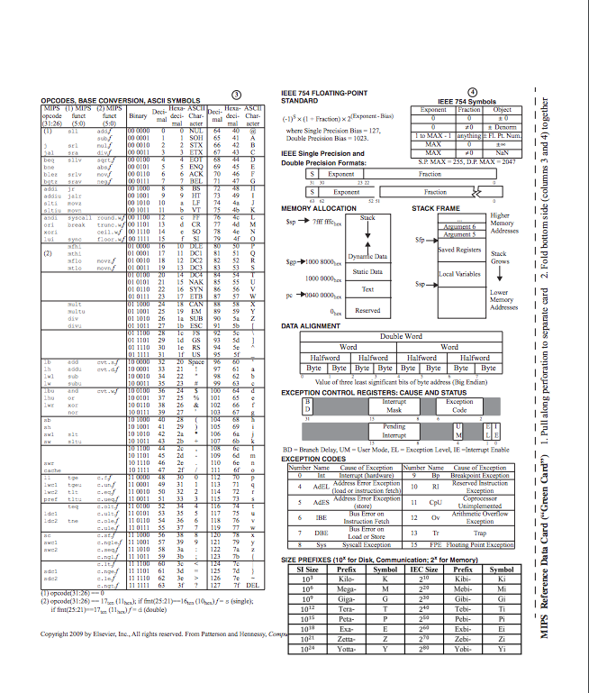
Unsigned Inequalities
Unsigned versions of slt(i):
sltu dst,src1,src2: unsigned comparison
sltiu dst,src,imm: unsigned comparison against constant
Example:
addi $s0,$0,-1
slti $t0,$s0,1
sltiu $t1,$s0,1
# $s0=0xFFFFFFFF
# $t0=1 (-1 < 1)
# $t1=0 (2³²-1 >>> 1)
Notes:
Do this first

Slide 13
Aside: MIPS Signed vs. Unsigned
MIPS terms “signed” and “unsigned” appear in 3 different contexts:
Signed vs. unsigned bit extension
lb,lh
lbu,lhu
Detect vs. don’t detect overflow
add, addi, sub, mult, div
addu, addiu, subu, multu, divu
Signed vs. unsigned comparison
slt, slti
sltu, sltiu

Slide 14
Inequalities in MIPS
Set Less Than (Unsigned) (slt(u))
slt(u) dst,reg1,reg2
if value in src1 < value in src2, dst = 1, else 0
Set Less Than Immediate (Unsigned) (slti(u))
slti(u) dst,reg1,imm
If value in reg1 < imm, dst = 1, else 0
Combine with bne, beq, and $0
Four Inequality tests: <, <=, >, and >=
RISC: implement all with just slt(i)(u)

Slide 15
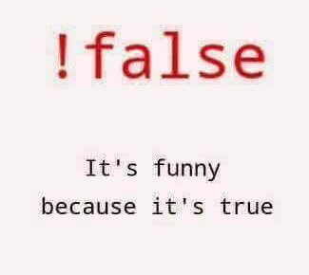
Breaking Down the If Else
C Code:
MIPS:
!(i>j)=!(j<i)
if(!(j<i)) {
if(i<=j) {
a = b /* then */
} else {
a = -b /* else */
}
In English:
If TRUE, execute the THEN block
If FALSE, execute the ELSE block
# i→$s0, j→$s1
# a→$s2, b→$s3
slt $t0 $s1 $s0
bne $t0,$0,else
then:
add $s2, $s3, $0
j end
else:
sub $s2, $0, $s3
end:
??? ???
???
Notes:
add animation to change i<=j to !(j<i)

Slide 16
Breaking Down the If Else
C Code:
MIPS:
!(i<j)
if(!(i<j)) {
if(i>=j) {
a = b /* then */
} else {
a = -b /* else */
}
In English:
If TRUE, execute the THEN block
If FALSE, execute the ELSE block
# i→$s0, j→$s1
# a→$s2, b→$s3
slt $t0 $s0 $s1
bne $t0,$0,else
then:
add $s2, $s3, $0
j end
else:
sub $s2, $0, $s3
end:
??? ???
???
Notes:
after this introduce pseudoinstructions for branching
mention pseudoinsts,

Slide 17
Last Time: Breaking Down the If Else
C Code:
MIPS:
if(i<j) {
a = b /* then */
} else {
a = -b /* else */
}
In English:
If TRUE, execute the THEN block
If FALSE, execute the ELSE block
# i→$s0, j→$s1
# a→$s2, b→$s3
slt $t0 $s0 $s1
beq $t0,$0,else
then:
add $s2, $s3, $0
j end
else:
sub $s2, $0, $s3
end:

Slide 18
Question: What C code properly fills in the
following blank?
do {i--;} while(_________);
Loop: # i→$s0, j→$s1
addi $s0,$s0,-1 # i = i - 1 slti $t0,$s1,2 # $t0 = (j < 2) beq $t0,$0 ,Loop # goto Loop if $t0==0
slt $t0,$s1,$s0 # $t0 = (j < i) bne $t0,$0 ,Loop # goto Loop if $t0!=0
(A)
j ≥ 2 || j < i
(B)
j ≥ 2 && j < i
(C)
j < 2 || j ≥ i
(D)
j < 2 && j ≥ i
Notes:
!False = true comic

Slide 19
Question: What C code properly fills in the
following blank?
do {i--;} while(_________);
Loop: # i→$s0, j→$s1
addi $s0,$s0,-1 # i = i - 1 slti $t0,$s1,2 # $t0 = (j < 2) beq $t0,$0 ,Loop # goto Loop if $t0==0
slt $t0,$s1,$s0 # $t0 = (j < i) bne $t0,$0 ,Loop # goto Loop if $t0!=0
(A)
j ≥ 2 || j < i
j ≥ 2 && j < i
(B)
PSEUDOINSTRUCTIONS
TO THE RESCUE!
(C)
j < 2 || j ≥ i
(D)
j < 2 && j ≥ i
Notes:
!False = true comic

Slide 20
Agenda
More Memory Instructions
Inequalities
Administrivia
Pseudo-Instructions
Implementing Functions in MIPS
Function Calling Conventions
Bonus: Remaining Registers
Bonus: Memory Address Convention
Bonus: Alternate Register Convention Analogy
Notes:
do additional slt stuff
Then do additional memory instructions
then summarize unsigned?

Slide 21
Administrivia
HW1 due tomorrow & Proj1 due Thurs 6/29
HW2 released, due Monday 7/3
MT1 on 7/11 during lecture time
Location: Dwinelle 155
Attend Guerilla Session for extra practice!
Time: Tomorrow (Wed) 5-7pm
Location: Cory 540AB—also have Cory 521 if needed
Sent out emails to everyone who didn’t register their and iClicker with us

Slide 22
Agenda
More Memory Instructions
Inequalities
Administrivia
Pseudo-Instructions
Implementing Functions in MIPS
Function Calling Conventions
Bonus: Remaining Registers
Bonus: Memory Address Convention
Bonus: Alternate Register Convention Analogy
Notes:
do additional slt stuff
Then do additional memory instructions
then summarize unsigned?

Slide 23
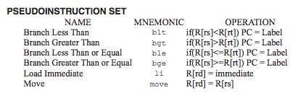
Assembler Pseudo-Instructions
more intuitive for programmers, but NOT directly implemented in hardware
translated later into instructions which are directly implemented in hardware
Example:
move dst,src translated into
addi dst,src,0 or add dst,src,$0
Notes:
First 4 get expanded into slt and beq/ne as we have done before
THIS LIST IS INCOMPLETE

Slide 24
More Pseudo-Instructions
Load Immediate (li)
li dst,imm
Loads 32-bit immediate into dst
translates to: addi(u) dst $0 imm
Load Address (la)
la dst,label
Loads address of specified label into dst
(translation omitted for now)

Slide 25
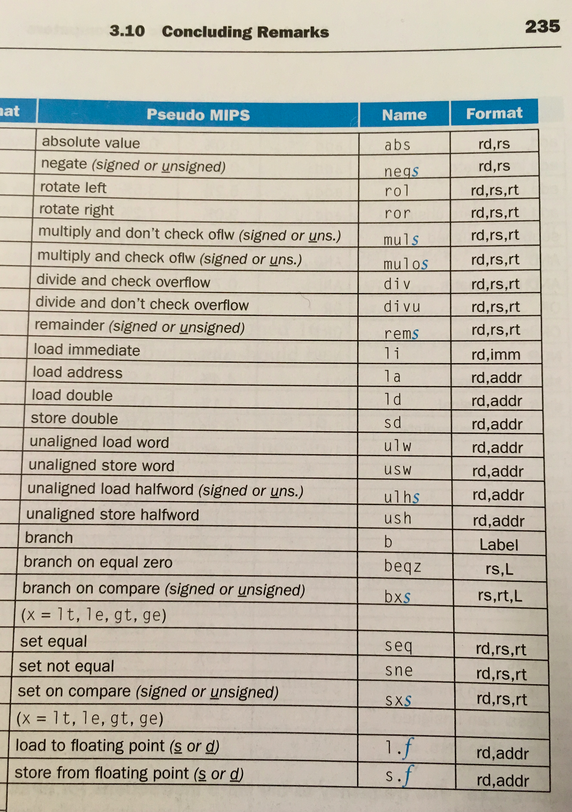
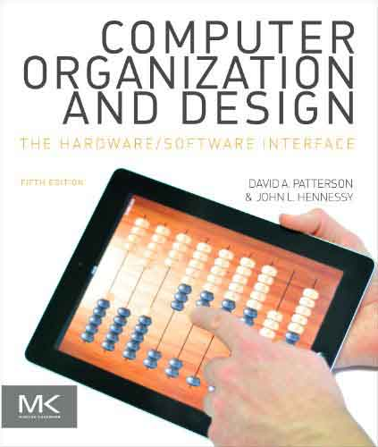
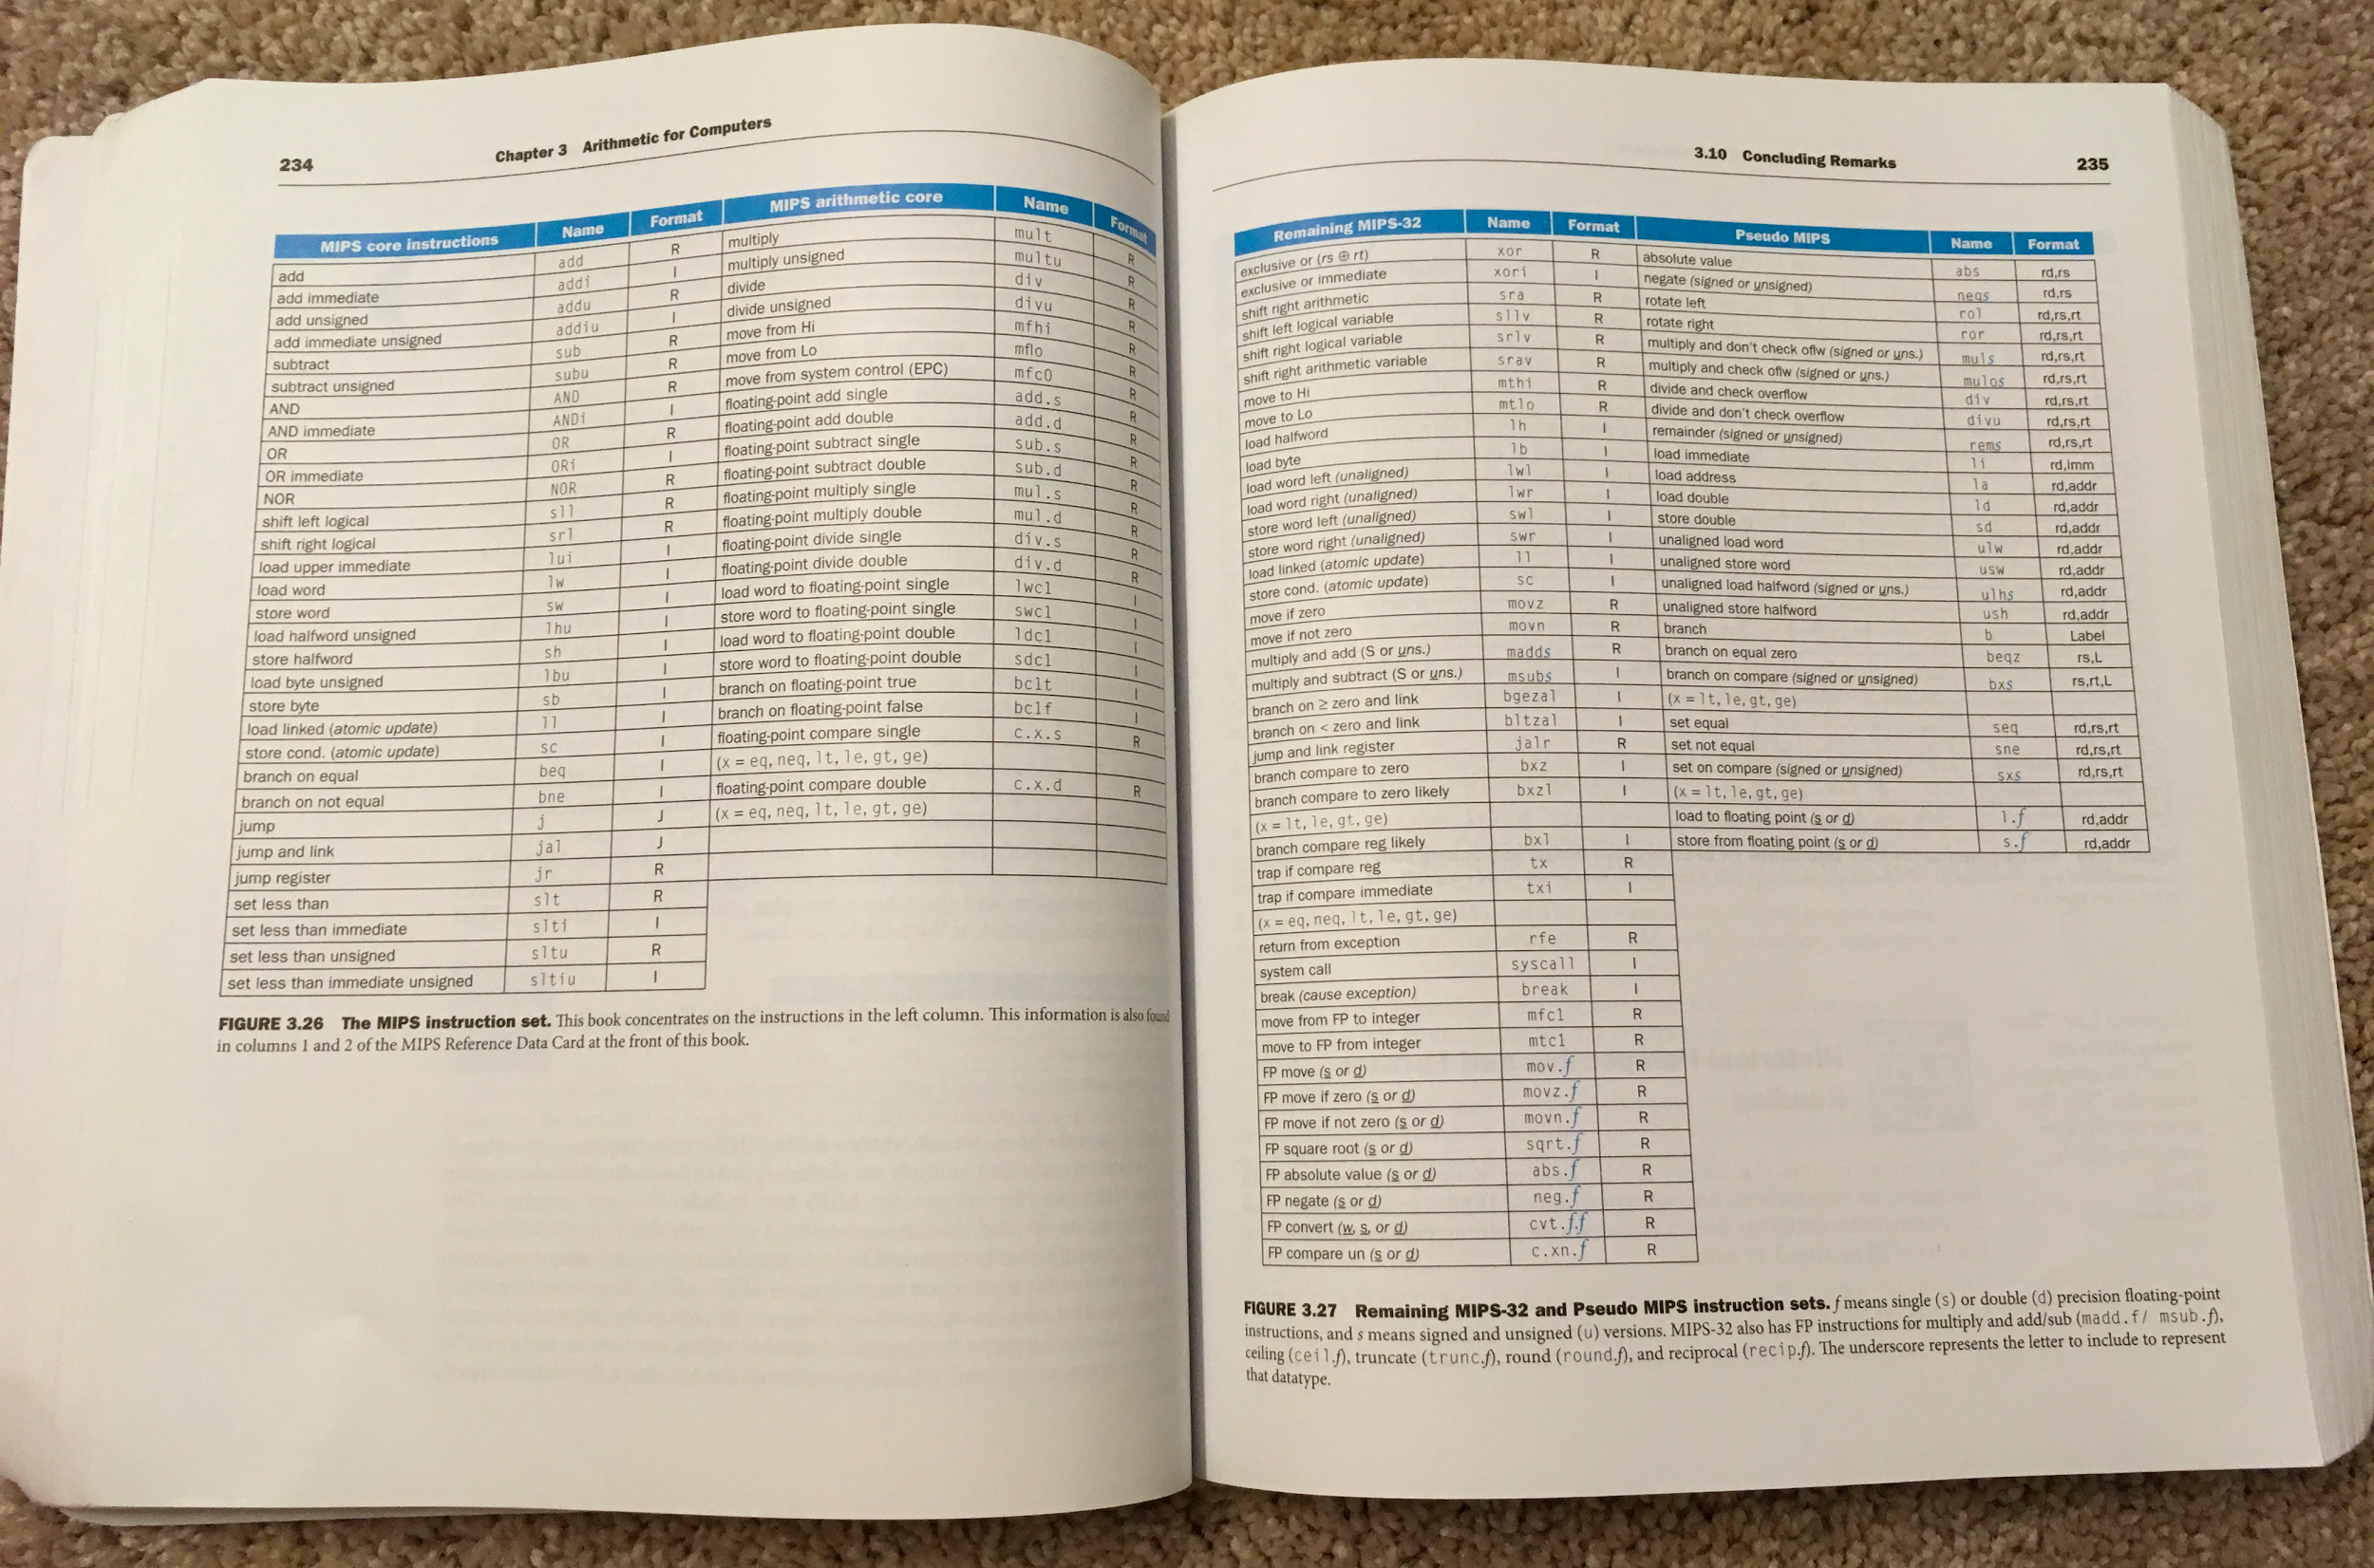
Even More PseudoInstructions
MARS supports 270 pseudo-instructions (see Help)
Don’t go overboard: avoid confusing yourself!

Slide 26
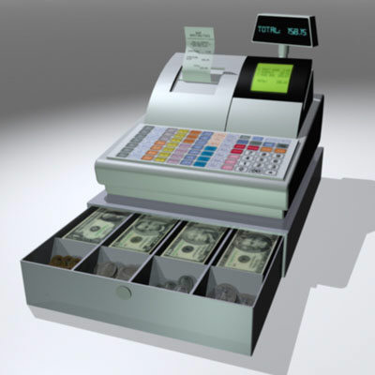
More Registers
$at: “assembler temporary”Problem:
Reserved for assembler use: when breaking up a pseudo-instruction, the assembler may need to use an extra register

Slide 27
MAL vs. TAL
True Assembly Language (TAL)
The instructions a computer understands and executes (directly implemented in hardware!)
MIPS Assembly Language (MAL)
Instructions the assembly programmer can use (includes pseudo-instructions)
Each MAL instruction becomes 1 or more TAL instruction
TAL ⊂ MAL

Slide 28
Agenda
More Memory Instructions
Inequalities
Administrivia
Pseudo-Instructions
Implementing Functions in MIPS
Function Calling Conventions
Bonus: Remaining Registers
Bonus: Memory Address Convention
Bonus: Alternate Register Convention Analogy
Notes:
do additional slt stuff
Then do additional memory instructions
then summarize unsigned?

Slide 29
Six Steps of Calling a Function
Put arguments in a place where the function can access them
Transfer control to the function
The function will acquire any (local) storage resources it needs
The function performs its desired task
The function puts return value in an accessible place and “cleans up”
Control is returned to you

Slide 30
1 and 5: Where should we put the arguments and return values?
Registers way faster than memory, so use them whenever possible
$a0–$a3: four argument registers to pass parameters
$v0–$v1: two value registers to return values
Order of arguments matters
If need extra space, use the stack!

Slide 31
More Registers
$at: “assembler temporary”Problem:
Reserved for assembler use: when breaking up a pseudo-instruction, the assembler may need to use an extra register
$a0–$a3: four argument registers to pass parameters
$v0–$v1: two value registers to return values

Slide 32
More Registers
$at: “assembler temporary”Problem:
Reserved for assembler use: when breaking up a pseudo-instruction, the assembler may need to use an extra register
$a0–$a3: four argument registers to pass parameters
$v0–$v1: two value registers to return values
$sp: “stack pointer”

Slide 33
2 and 6: How do we Transfer Control?
Jump (j)
j label
Jump Register (jr)
jr src
Jump and Link (jal)
jal label
Jump and Link Register (jalr)
jalr src
“and Link”: Saves the location of following instruction in register $31 before jumping
$ra = $31: return address register that saves where a function is called from
Used to return from a function
(src = $ra)
Used to invoke
a function

Slide 34
More Registers
$at: “assembler temporary”Problem:
Reserved for assembler use: when breaking up a pseudo-instruction, the assembler may need to use an extra register
$a0–$a3: four argument registers to pass parameters
$v0–$v1: two value registers to return values
$sp: “stack pointer”
$ra: “return address” (address of code that made a function call)

Slide 35
Instruction Addresses
Instructions are stored as data in memory!
Recall: Code section
(not one of the 31 registers! not a local variable)
Labels get converted to instruction addresses
jal puts the address of an instruction in $ra
More on this next lecture
How does the processor know where to find the current code?
~ FFFF FFFF_{hex}
stack
heap
static data
code
~ 0_{hex}

Slide 36
Program Counter
The program counter (PC) is a special register that holds the address of the current instruction being executed
inaccessible to the programmer (not one of the 32 local variables), but accessible to jal
All branches and jumps (beq, bne, j, jal, jr) work by storing an address into PC
Notes:
MIPS Green Sheet shows that jal stores PC+8 into $ra – we’ll explain why much later in the semester.

Slide 37
Linking
jal puts the address of an instruction in $ra
MIPS: instructions are 4 bytes long
Recall: Memory is byte-addressed
0x0040061C jal newMoney
0x00400620 (add 4)
Due to pipelining…
For now: PC+4
What would happen if we stored PC instead?

Slide 38


Meet the $taff
 | Derek | Zubair
Favorite artist? | Ratatat | Drake
Bribe food? | Poke bowls | Reese’s cups and sugar cookies
Favorite game? | LoL & Codenames | COD Black Ops 1
Coolest place you've been to? | Nepal | Vegas

Slide 39
Six Steps of Calling a Function
Put arguments in a place where the function can access them
Transfer control to the function
The function will acquire any (local) storage resources it needs
The function performs its desired task
The function puts return value in an accessible place and “cleans up”
Control is returned to you
$a0-$a3
jal
$v0-$v1
jr

Slide 40
Agenda
More Memory Instructions
Inequalities
Administrivia
Pseudo-Instructions
Implementing Functions in MIPS
Function Calling Conventions
Bonus: Remaining Registers
Bonus: Memory Address Convention
Bonus: Alternate Register Convention Analogy
Notes:
do additional slt stuff
Then do additional memory instructions
then summarize unsigned?

Slide 41
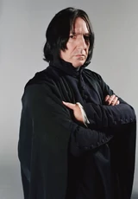

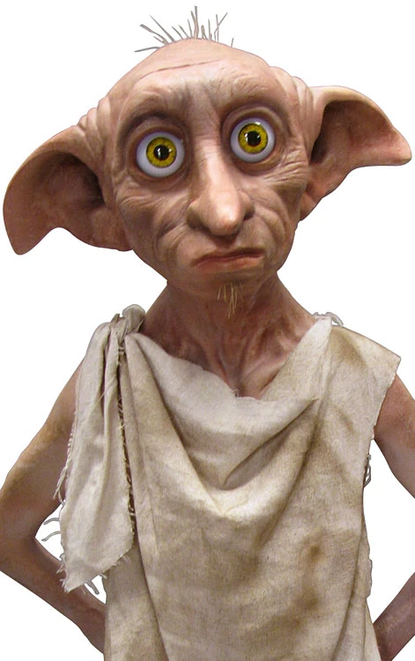
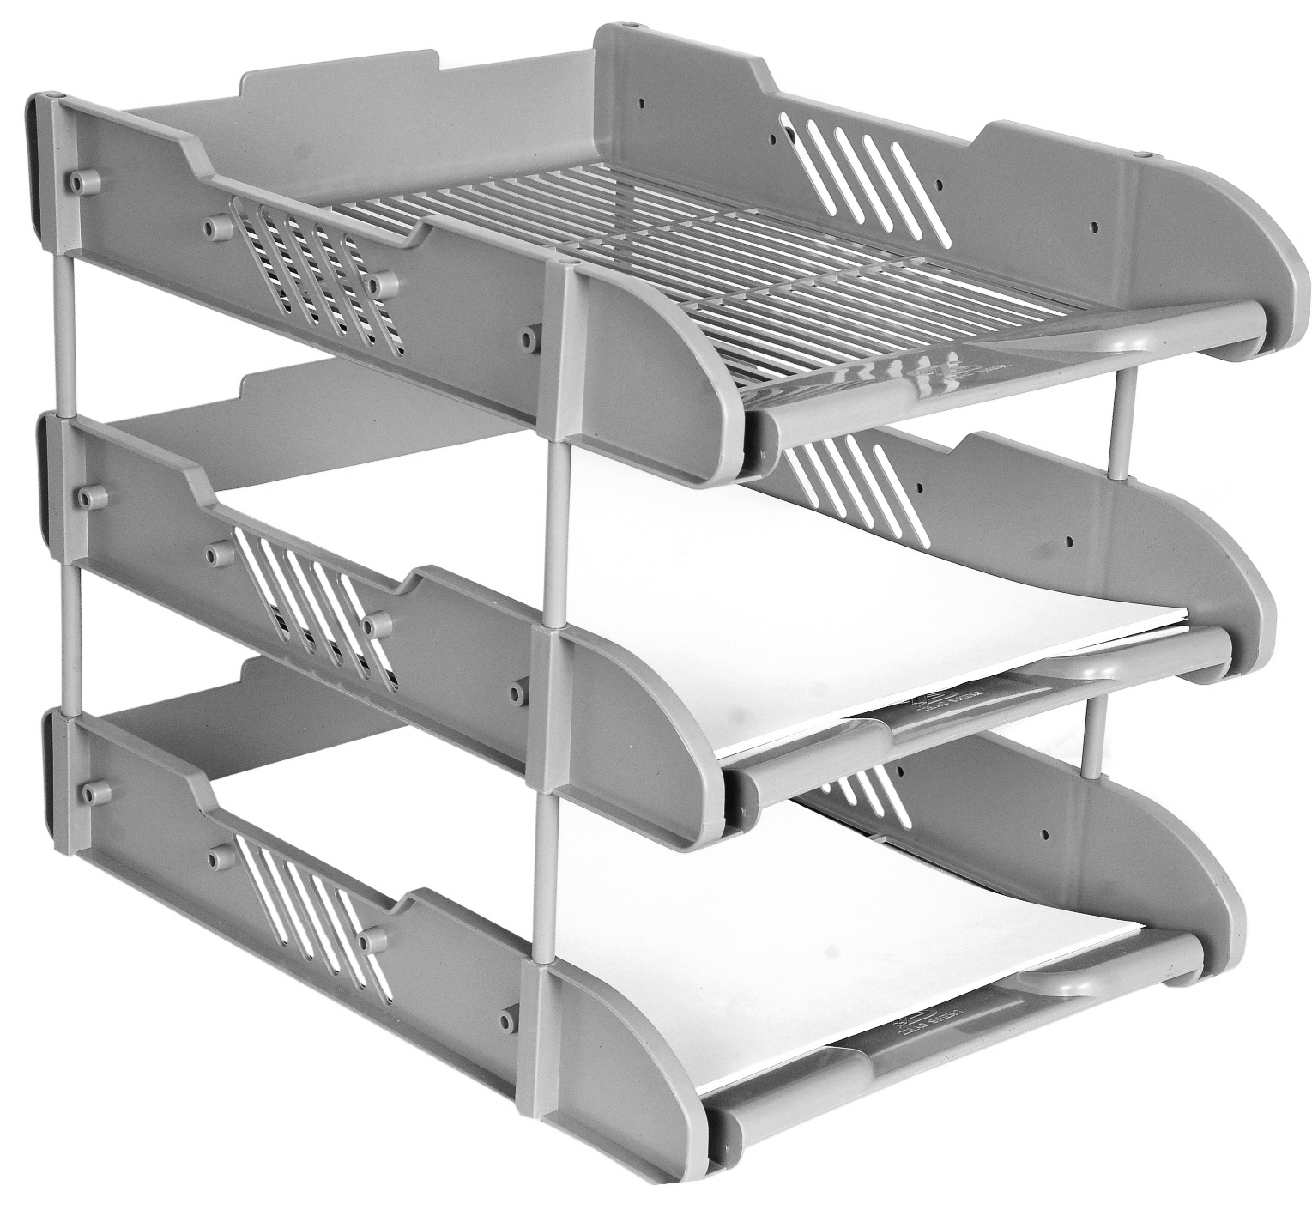


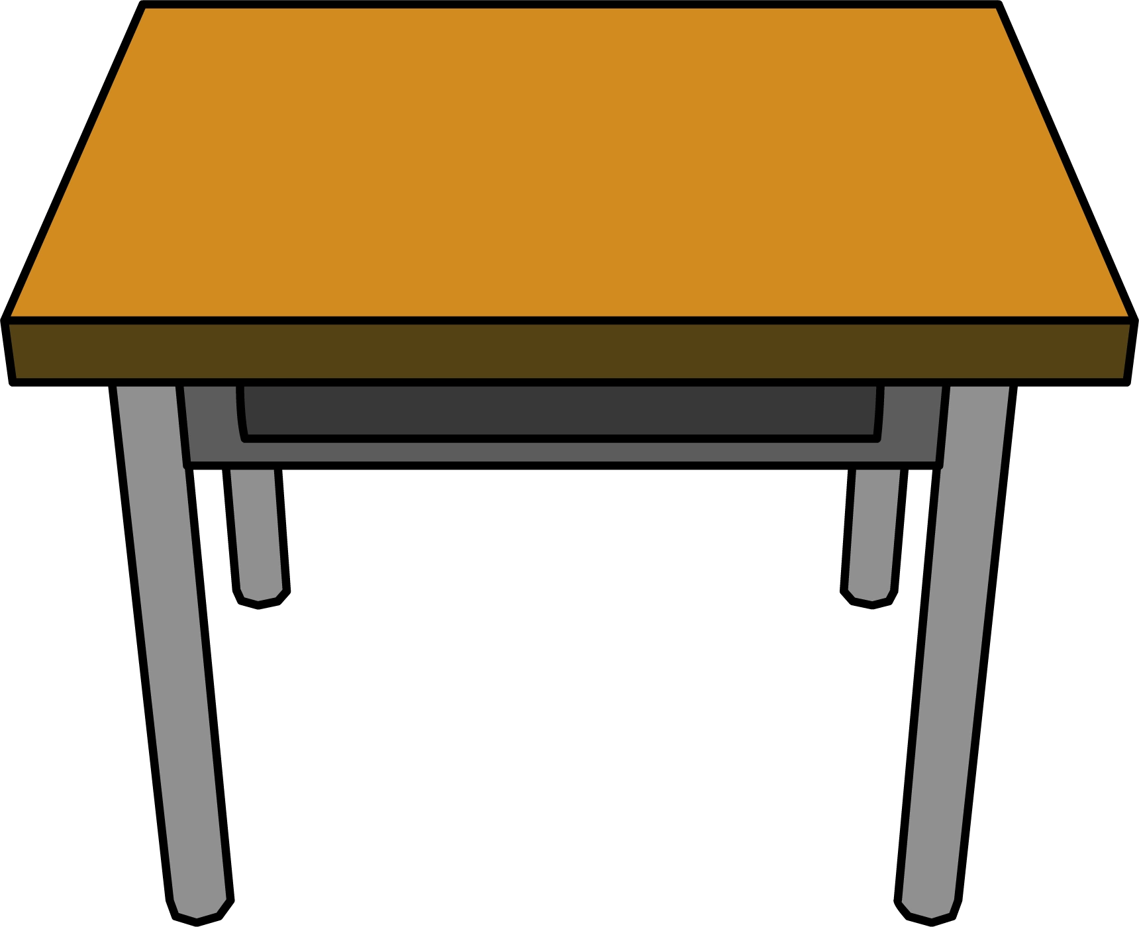

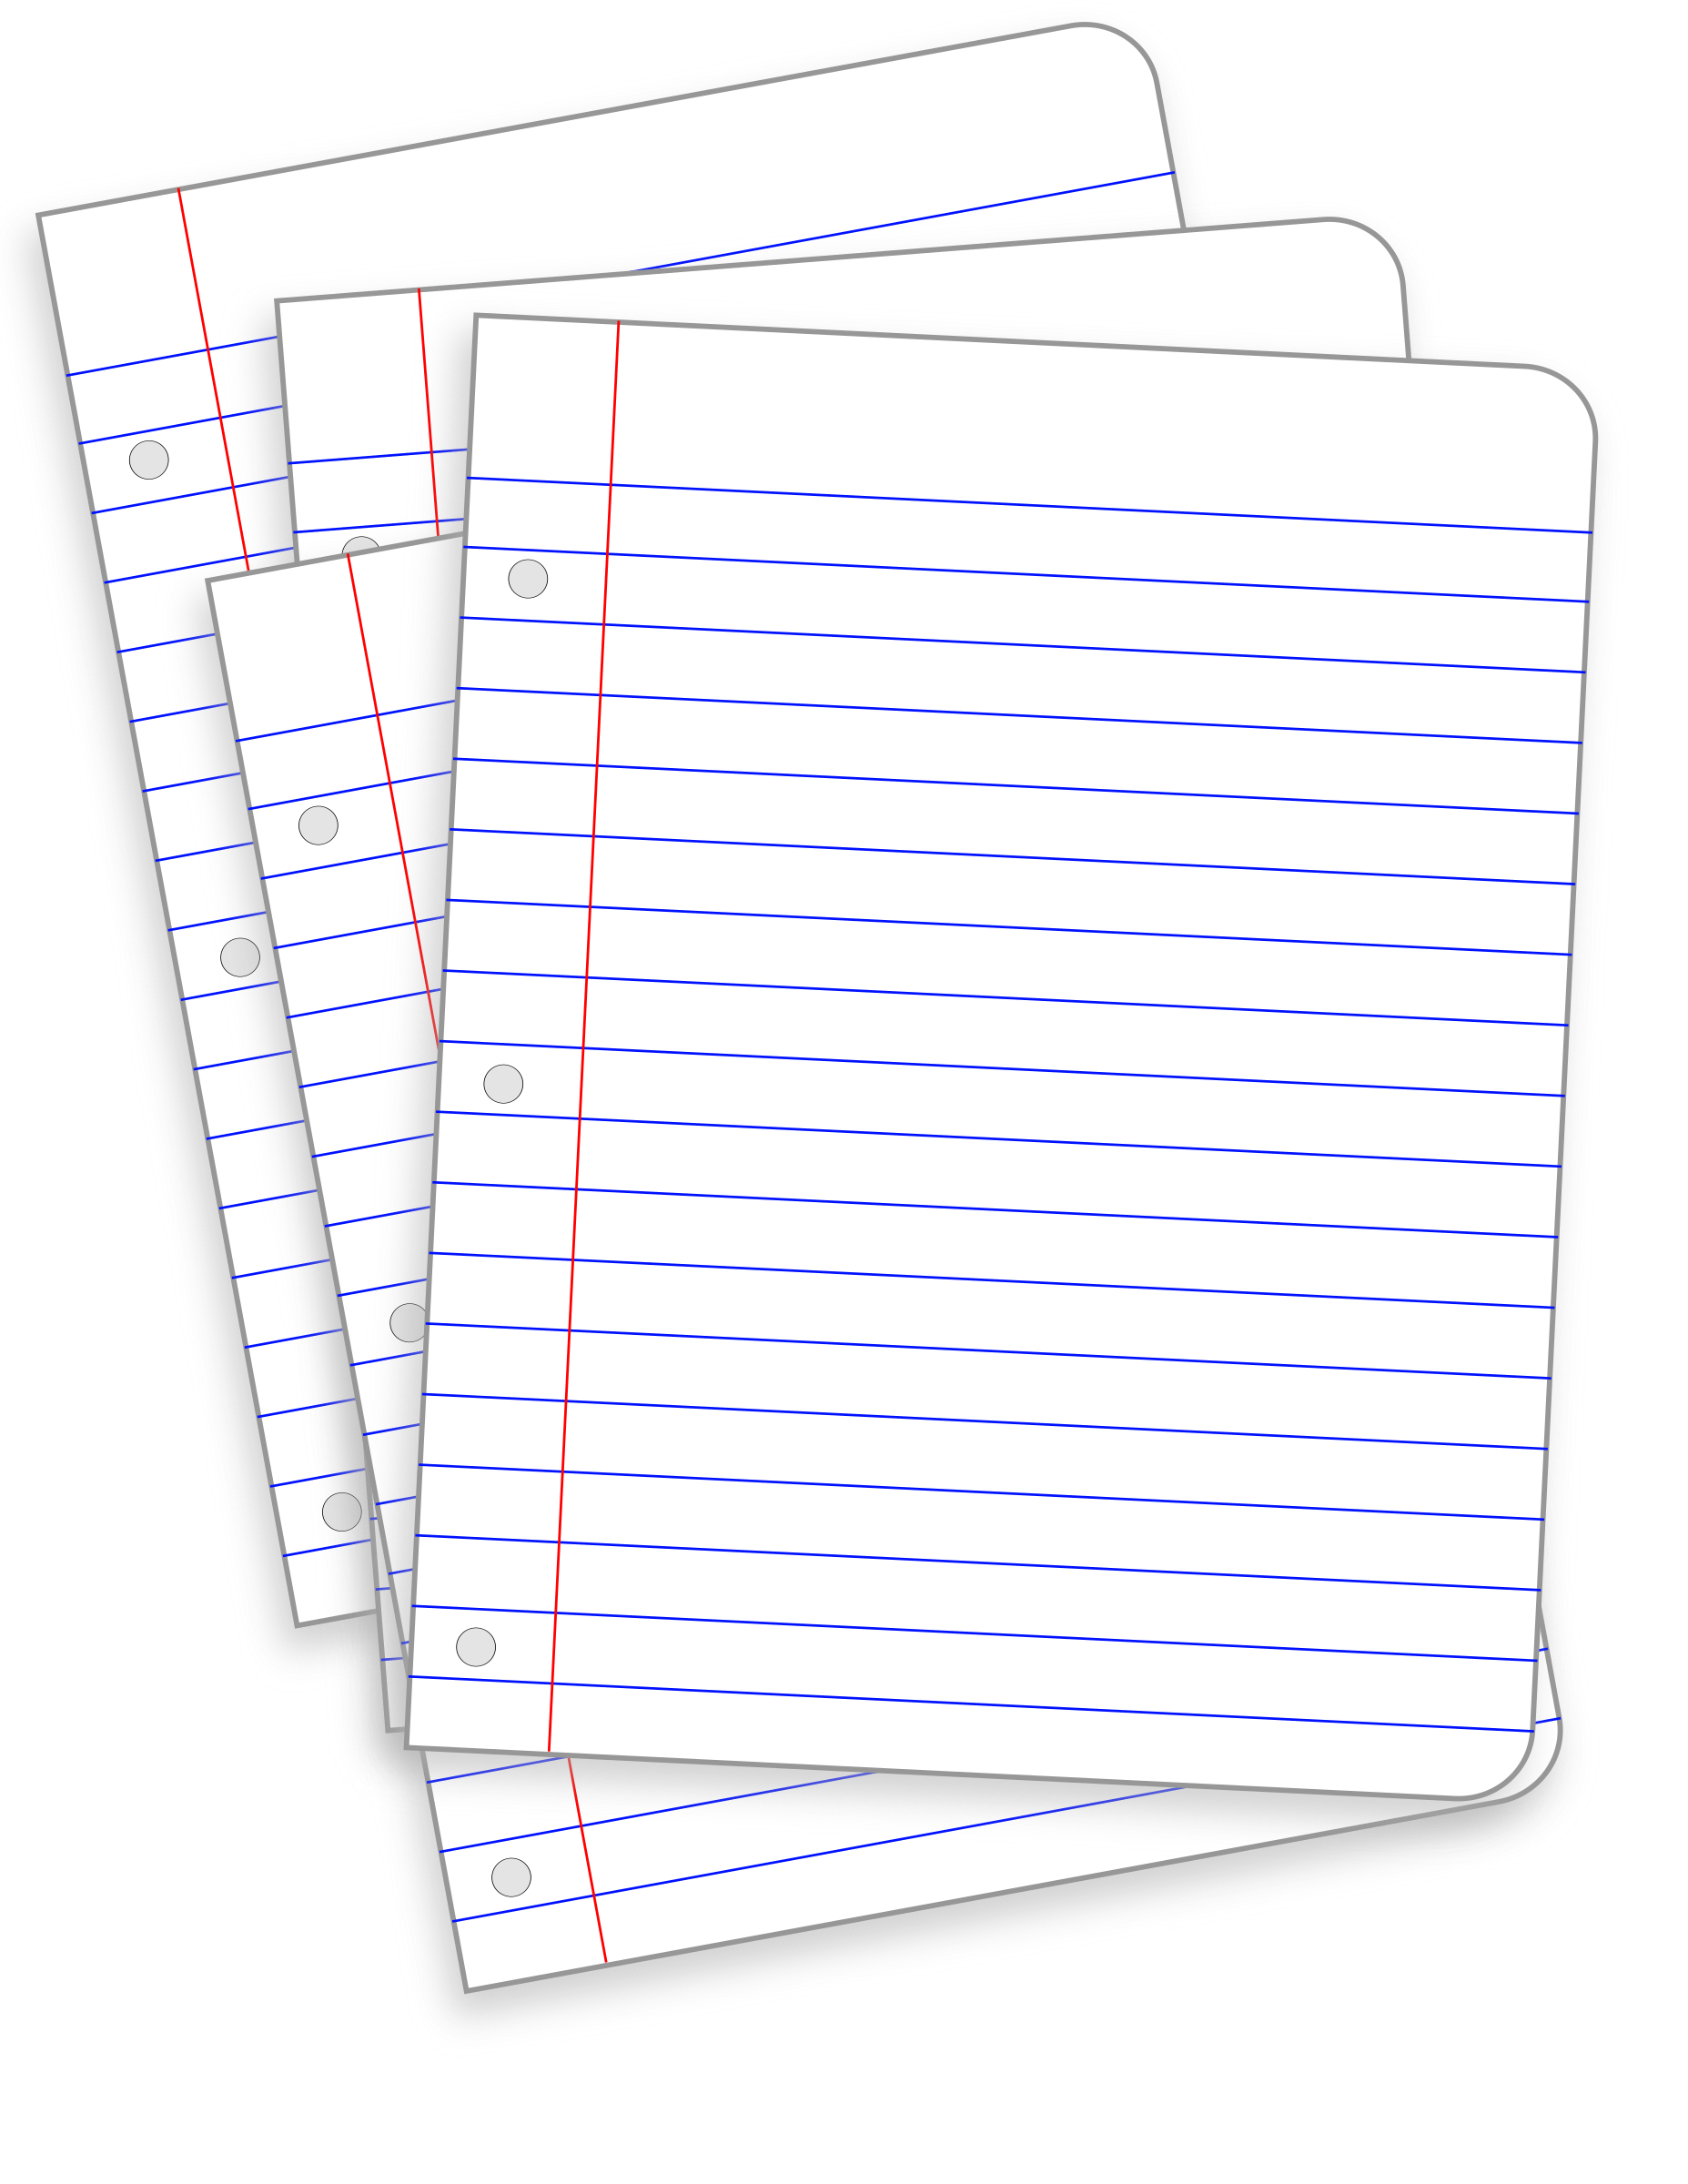


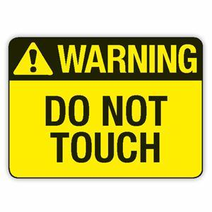
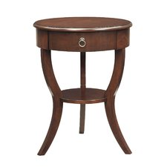

Calling Conventions -- A Metaphor: Sharing Space
$s
Safe to leave things here
Completed potions
Caller
Callee/Caller
You can move these, but you have to put them back
NOT safe to leave things here
Callee
Save these before you replace them
$t
$v
$ra
You can trash these
Stack
$a
You can put things on the stack, but you have to take them off afterwards
Put everything back
Before you call your assistant:
leave directions in $a
leave your number in $ra
move your papers so they’ll be safe
Notes:
For best results, view in “present mode”

Slide 42
Register Conventions
CalleR: the calling function
CalleE: the function being called
Register Conventions: A set of generally accepted rules as to which registers will be unchanged after a procedure call (jal) and which may have changed
Notes:
An individual function can be both a calleR and a calleE.

Slide 43
Recall: Memory Layout
Address
∞
stack
local variables
Dynamically allocated space
Global variables, string literals
Program instructions
$sp
heap
static data
code
0

Slide 44
Using Stack to Backup Registers
Limited number of registers for everyone to use (limited desk space)
All functions use the same conventions -- look for arguments/return addresses in the same places
What happens if a function calls another function?
($ra would get overwritten!)

Slide 45
Saved Registers
These registers are expected to be the same before and after a function call
If calleE uses them, it must restore values before returning
This means save the old values, use the registers, then reload the old values back into the registers
$s0-$s7 (saved registers)
$sp (stack pointer)
If not in same place, the caller won’t be able to properly restore values from the stack
$ra (return address)
$ra

Slide 46
Volatile Registers
These registers can be freely changed by the calleE
If calleR needs them, it must save those values before making a procedure call
$t0-$t9 (temporary registers)
$v0-$v1 (return values)
These will contain the new returned values
$a0-$a3 (return address and arguments)
These will change if calleE invokes another function (nested function means calleE is also a calleR)
$t
$a

Slide 47
Basic Structure of a Function
func_label: addi $sp,$sp, -framesize sw $ra, <framesize-4>($sp) save other regs if need be
restore other regs if need be lw $ra, <framesize-4>($sp)
addi $sp,$sp, framesize jr $ra
Prologue
$ra
Body (call other functions…)
...
...
Epilogue
ra
$ra
stack
Notes:
Substitute the proper immediate for <framesize-4>.
Can order registers on stack however you want to, but must make sure to restore them properly.

Slide 48
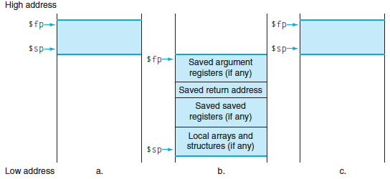
Stack Before, During, After Call
$ra
Notes:
Exact ordering of saved registers is up to you (make sure you keep track, though!).
(actually don’t need to save argument registers)

Slide 49
Local Variables and Arrays
Any local variables the compiler cannot assign to registers will be allocated as part of the stack frame (Recall: spilling to memory)
Locally declared arrays and structs are also allocated as part of the stack frame
Stack manipulation is same as before
Move $sp down an extra amount and use the space it created as storage

Slide 50
Register Conventions Summary
One more time for luck:
CalleR must save any volatile registers it is using onto the stack before making a procedure call
CalleR can trust saved registers to maintain values
CalleE must “save” any saved registers it intends to use by putting them on the stack before overwriting their values
Notes:
CalleR and calleE only need to save the appropriate registers they are using (not all!)
Don’t forget to restore the values later

Slide 51
Summary (1/2)
More instructions: lb, sb, lh, sh, lbu, lhu, sltu, sltiu
Pseudo-instructions make code more readable
Count as MAL, later translated into TAL
$at for assembler use
MIPS function implementation:
Jump and link (jal) invokes, jump register (jr $ra) returns
Registers $a0-$a3 for arguments, $v0-$v1 for return values, $ra for return address, $sp for stack

Slide 52
Question: Which statement below is TRUE about converting the following C code to MIPS?
int factorial(int n) {
if(n == 0) return 1;
else return(n*factorial(n-1));
}
(A)
This function must be implemented recursively
(B)
We can write this function without using any saved or temporary registers
(C)
We must save $ra on the stack since we need to know where to return to
(D)
It is the calleE’s job to save the argument registers to the stack before overwriting them

Slide 53
Question: Which statement below is TRUE about converting the following C code to MIPS?
int factorial(int n) {
if(n == 0) return 1;
else return(n*factorial(n-1));
}
(A)
This function must be implemented recursively
(B)
We can write this function without using any saved or temporary registers
If we implement it recursively, we only need $a and $v registers!
(C)
We must save $ra on the stack since we need to know where to return to
If we implement it iteratively, we don’t overwrite $ra
It is the calleE’s job to save the argument registers to the stack before overwriting them
(D)
$a registers don’t need to be saved

Slide 54
Question: Which statement below is TRUE about converting the following C code to MIPS?
int factorial(int n) {
if(n == 0) return 1;
else return(n*factorial(n-1));
}
(A)
This function must be implemented recursively
(B)
We can write this function without using any saved or temporary registers
(C)
We must save $ra on the stack since we need to know where to return to
(D)
It is the calleE’s job to save the argument registers to the stack before overwriting them

Slide 55
Summary (2/2)
Register conventions preserves values of registers between function calls
Different responsibilities for calleR and calleE
Registers classified as saved and volatile
Use the Stack for spilling registers, saving return address, and local variables

Slide 56
BONUS SLIDES
You are responsible for the material contained on the following slides, though we may not have enough time to get to them in lecture.
You may learn the material just by doing other coursework, but hopefully these slides will help clarify the material.

Slide 57
Function Call Example
... sum(a,b); ... /* a→$s0,b→$s1 */
int sum(int x, int y) { return x+y; }
1000 addi $a0,$s0,0 # x = a
1004 addi $a1,$s1,0 # y = b
1008 addi $ra,$zero,1016 # $ra=1016
1012 j sum # jump to sum
1016
...
2000 sum: add $v0,$a0,$a1
2004 jr $ra # return
C
MIPS
address (decimal)
Would we know this before compiling?
Otherwise we don’t know where we came from
jr $ra

Slide 58
Function Call Example
... sum(a,b); ... /* a→$s0,b→$s1 */
int sum(int x, int y) { return x+y; }
1000 addi $a0,$s0,0 # x = a
1004 addi $a1,$s1,0 # y = b
1008 jal sum # $ra=1012, goto sum
1012
...
2000 sum: add $v0,$a0,$a1
2004 jr $ra # return
C
MIPS
address (decimal)

Slide 59
Example: sumSquare
int sumSquare(int x, int y) {
return mult(x,x)+ y; }
What do we need to save?
Call to mult will overwrite $ra, so save it
Reusing $a1 to pass 2nd argument to mult, but need current value (y) later, so save $a1
To save something to the Stack, move $sp down the required amount and fill the “created” space
Notes:
In general, you would also want to save $a0 to the Stack, in case the function you call calls another function can overwrites $a0.

Slide 60
Example: sumSquare
int sumSquare(int x, int y) { return mult(x,x)+ y; }
sumSquare:
addi $sp,$sp,-8 # make space on stack
sw $ra, 4($sp) # save ret addr
sw $a1, 0($sp) # save y
add $a1,$a0,$zero # set 2nd mult arg
jal mult # call mult
lw $a1, 0($sp) # restore y
add $v0,$v0,$a1 # ret val = mult(x,x)+y
lw $ra, 4($sp) # get ret addr
addi $sp,$sp,8 # restore stack
jr $ra
mult: ...
“push”
“pop”

Slide 61
Example: Using Volatile Registers
myFunc: # Uses $t0
addiu $sp,$sp,-4
sw $ra,0($sp) # Save saved registers
... # Do stuff with $t0
addiu $sp,$sp,-4 # Save volatile registers
sw $t0,0($sp) # before calling a function
jal func1 # Function may change $t0
lw $t0,0($sp) # Restore volatile registers
addiu $sp,$sp,4 # before you use them again
... # Do stuff with $t0
lw $ra,0($sp)
addiu $sp,$sp,4 # Restore saved registers
jr $ra # return
# This is the Prologue
# This is the Epilogue

Slide 62
Example: Using Saved Registers
myFunc: # Uses $s0 and $s1
addiu $sp,$sp,-12 # This is the Prologue
sw $ra,8($sp) # Save saved registers
sw $s0,4($sp)
sw $s1,0($sp)
... # Do stuff with $s0 and $s1
jal func1 # $s0 and $s1 unchanged by
... # function calls, so can keep
jal func2 # using them normally
... # Do stuff with $s0 and $s1
lw $s1,0($sp) # This is the Epilogue
lw $s0,4($sp) # Restore saved registers
lw $ra,8($sp)
addiu $sp,$sp,12
jr $ra # return
# This is the Prologue
# This is the Epilogue

Slide 63
Choosing Your Registers
Minimize register footprint
Optimize to reduce number of registers you need to save by choosing which registers to use in a function
Only save when you absolutely have to
Function does NOT call another function
Use only $t0-$t9 and there is nothing to save!
Function calls other function(s)
Values you need throughout go in $s0-$s7, others go in $t0-$t9
At each function call, check number arguments and return values for whether you or not you need to save
Notes:
Recall: memory is MUCH slower than registers.
The more you know about the internals of the other functions you call, the more you can get away with (e.g. using temporary registers that you know the other functions don’t use, so you don’t bother saving them across function calls).

Slide 64
Question: Which statement below is FALSE?
(A)
MIPS uses jal to invoke a function and jr to return from a function
(B)
jal saves PC+1 in $ra
(C)
The callee can use temporary registers ($ti) without saving and restoring them
(D)
The caller can rely on save registers ($si) without fear of callee changing them

Slide 65
Agenda
More Memory Instructions
Inequalities
Administrivia
Pseudo-Instructions
Implementing Functions in MIPS
Function Calling Conventions
Bonus: Remaining Registers
Bonus: Memory Address Convention
Bonus: Alternate Register Convention Analogy
Notes:
do additional slt stuff
Then do additional memory instructions
then summarize unsigned?

Slide 66
MIPS Registers
The constant 0 $0 $zero
Reserved for Assembler $1 $at
Return Values $2-$3 $v0-$v1
Arguments $4-$7 $a0-$a3
Temporary $8-$15 $t0-$t7
Saved $16-$23 $s0-$s7
More Temporary $24-$25 $t8-$t9
Used by Kernel $26-27 $k0-$k1
Global Pointer $28 $gp
Stack Pointer $29 $sp
Frame Pointer $30 $fp
Return Address $31 $ra

Slide 67
The Remaining Registers
$at (assembler)
Used for intermediate calculations by the assembler (pseudo-code); unsafe to use
$k0-$k1 (kernal)
May be used by the OS at any time; unsafe to use
$gp (global pointer)
Points to global variables in Static Data; rarely used
$fp (frame pointer)
Points to top of current frame in Stack; rarely used

Slide 68
Agenda
More Memory Instructions
Inequalities
Administrivia
Pseudo-Instructions
Implementing Functions in MIPS
Function Calling Conventions
Bonus: Remaining Registers
Bonus: Memory Address Convention
Bonus: Alternate Register Convention Analogy
Notes:
do additional slt stuff
Then do additional memory instructions
then summarize unsigned?

Slide 69
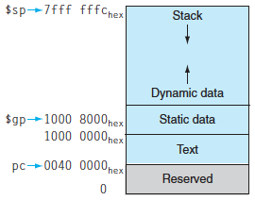
Memory Address Convention
(Heap)
(Code)
Notes:
Recall: Stack grows downwards (decreasing addresses)
Static Data starts at 0x1000 0000 and is of a fixed size. The Heap starts immediately above that.

Slide 70
Agenda
More Memory Instructions
Inequalities
Administrivia
Pseudo-Instructions
Implementing Functions in MIPS
Function Calling Conventions
Bonus: Remaining Registers
Bonus: Memory Address Convention
Bonus: Alternate Register Convention Analogy
Notes:
do additional slt stuff
Then do additional memory instructions
then summarize unsigned?

Slide 71
Register Convention Analogy (1/5)
Parents (calleR) leave for the weekend and give the keys to the house to their kid (calleE)
Before leaving, they lay down a set of rules (calling conventions):
You can trash the temporary rooms like the den and basement if you want; we don’t care about them (volatile registers)
BUT you’d better leave the rooms for guests (living, dining, bed, etc.) untouched (saved registers): “These rooms better look the same when we return!”

Slide 72
Register Convention Analogy (2/5)
Kid now “owns” all of the rooms (registers)
Kid is going to throw a wild, wild party (computation) and wants to use the guest rooms (saved registers)
So what does the kid (calleE) do?
Takes stuff from guest rooms and moves it to the shed in the backyard (memory)
Throws the party and everything in the house gets trashed (shed is outside, so it survives)
Restores guest rooms by replacing the items from the backyard shed

Slide 73
Register Convention Analogy (3/5)
Same scenario, except that during the party, the kid needs to run to the store for supplies
Kid (calleE) has left valuable stuff (data) all over the house
The party will continue, meaning the valuable stuff might get destroyed
Kid leaves friend (2nd calleE) in charge, instructing him/her on the rules of the house (conventions)
Here the kid has become the “heavy” (calleR)

Slide 74
Register Convention Analogy (4/5)
If kid has valuable stuff (data) in the temporary rooms (volatile registers) that are going to be trashed, there are three options:
Move stuff to the backyard shed (memory)
Move stuff to guest rooms (saved registers) whose contents have already been moved to the shed
Optimize lifestyle (code) so that the amount you’ve got to schlep back and forth from shed is minimized.
Mantra: “Minimize register footprint”
Otherwise: “Dude, where’s my data?!”

Slide 75
Register Convention Analogy (5/5)
Friend now “owns” all of the rooms (registers)
Friend decides to allow the wild, wild party (computation) to use the guest rooms (saved registers)
What does the friend (2nd calleE) do?
Takes stuff from guest rooms and moves it to the shed in the backyard (memory)
Throws the party and everything in the house gets trashed (shed is outside, so it survives)
Restores guest rooms by replacing the items from the backyard shed
Same as kid!

